Slide 1

VETRI VINAYAHA COLLEGE OF ENGINEERING AND TECHNOLOGY
ANNA UNIVERSITY : CHENNAI
OCT -2023

Slide 2
SUBMITTED BY
ELAVARASI G 623320104008
THIRUMAVALAVAN V 623320104024
VIMALRAJ M 623320104027
YASOTHA V 623320104028
Guided by
MR.A.SURYA
AP/CSE

Slide 3
PROJECT TITLE TRACKING PUBLIC INFRASTRUCTURE AND TOLL PAYMENT SYSTEM
DOMAIN : BLOCK CHAIN

Slide 4
ABSTRACT
In recent decades, blockchain has emerged as one of the popular technologies in recently and it has the ability to make a revolution in the intelligent transportation system.
Developing countries like India needs a significant improvement in infrastructure such as Roads or Highways.
We have developed a model which uses smart contracts in blockchain for the payment of toll fee. Also, our work focuses on the better distribution of traffic on highways by diverting the traffic on highways with lower traffic.

Slide 5
EXISTING SYSTEM
Blockchain systems, especially those using Proof of Work (PoW) or Proof of Stake (PoS) consensus mechanisms, can struggle to handle a high volume of transactions.
For toll payment systems specifically, there were initiatives in various countries to explore the use of blockchain technology.
For improving the efficiency and transparency of toll collection. However, these were often in the experimental or pilot stage.

Slide 6
DISADVANTAGES
Scalability: Blockchain networks, especially public ones, can face scalability issues as the number of transactions increases.
Regulatory Challenges: The regulatory environment for blockchain and cryptocurrencies can be complex and is subject to change.
Initial Development Costs: Implementing a blockchain-based infrastructure and toll payment system can involve significant upfront costs.

Slide 7
PROPOSED SYSTEM
This proposed system would combine the benefits of blockchain technology, such as transparency and security, with a user-friendly interface to streamline public infrastructure and toll payments.
It would require collaboration among multiple stakeholders, including government agencies, blockchain developers, and infrastructure operators.
Designing a public infrastructure and toll payment system using blockchain technology can enhance transparency, security, and efficiency.

Slide 8
ADVANTAGES
Transparency and Trust: Blockchain's decentralized ledger provides transparency, allowing all stakeholders to access and verify transaction records.
Reduced Fraud: Blockchain's immutability makes it difficult for fraudulent activities to occur.
Efficiency: Blockchain can streamline toll payment processes by automating transactions and reducing the need for intermediaries.

Slide 9
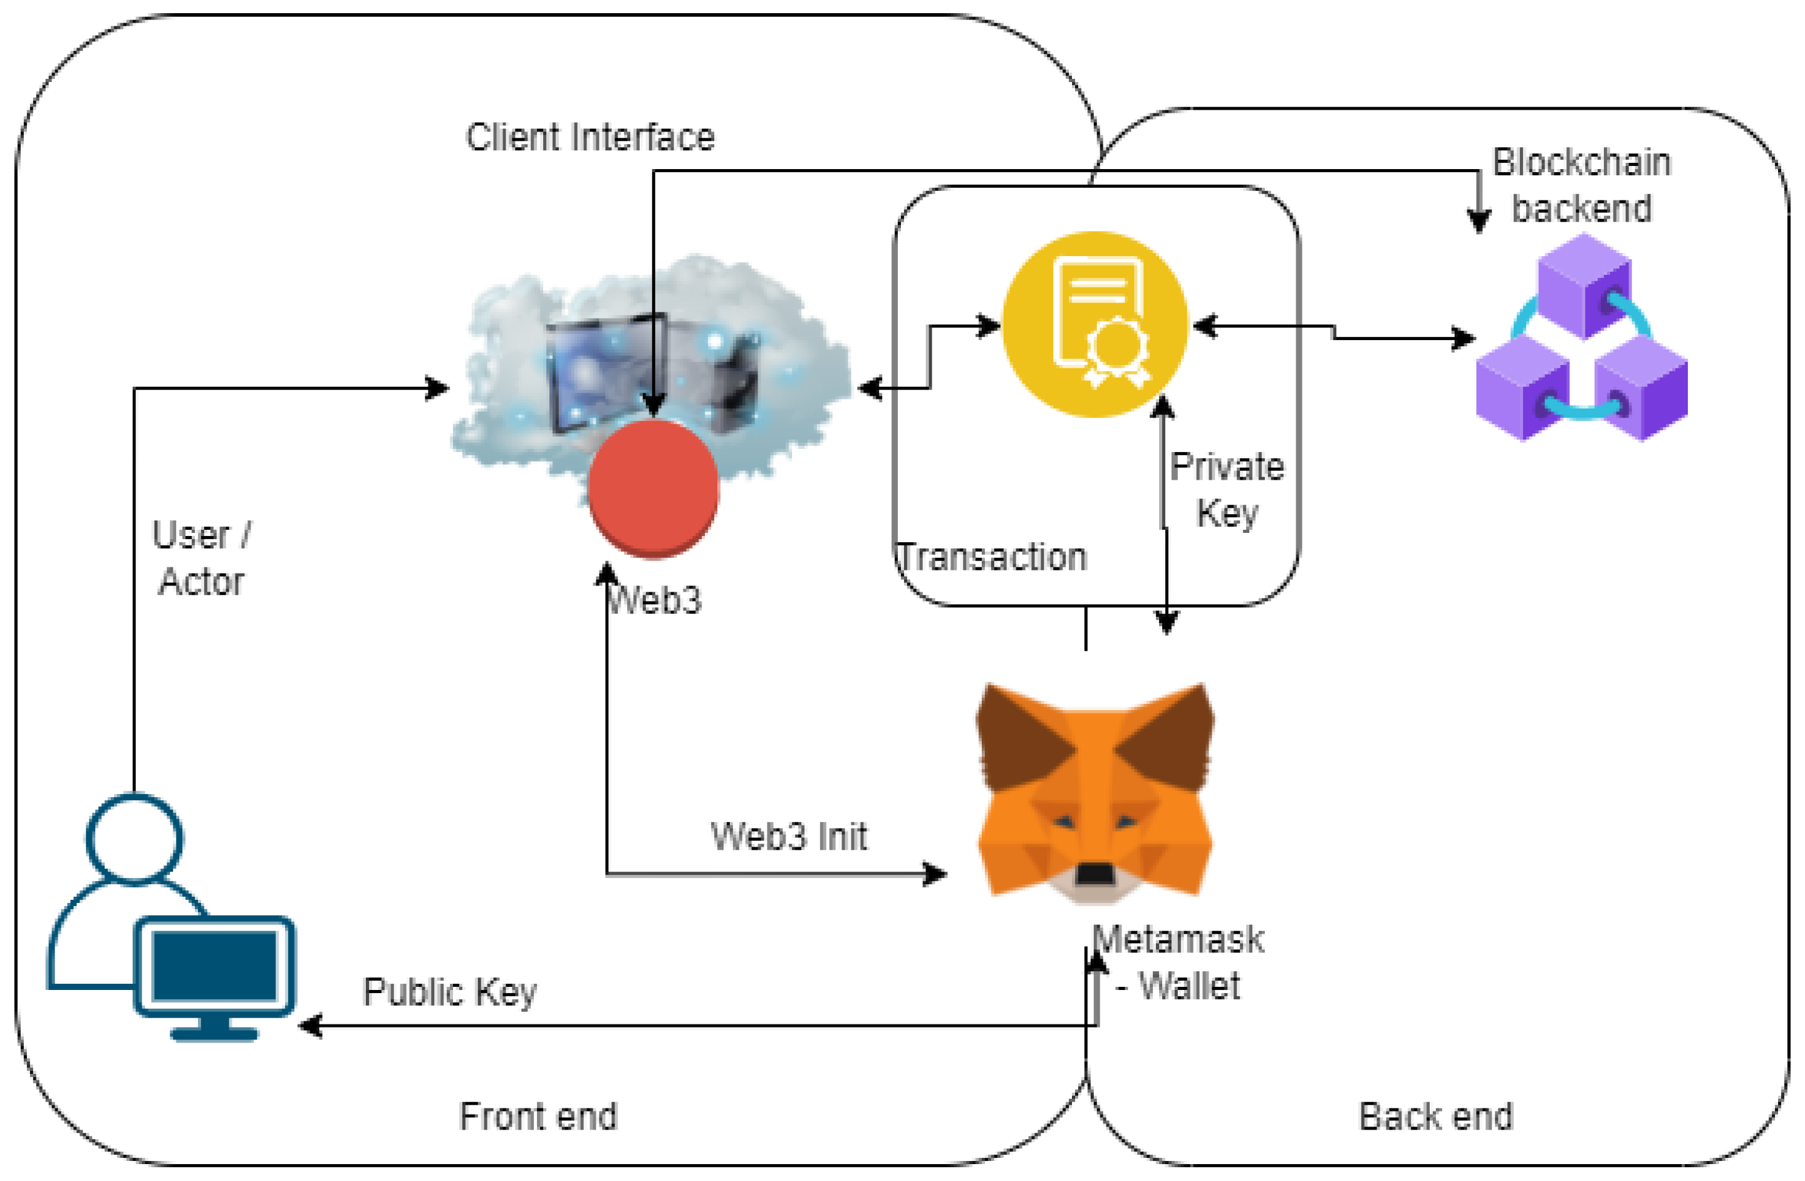
SOLUTION ARCHITECTURE

Slide 10
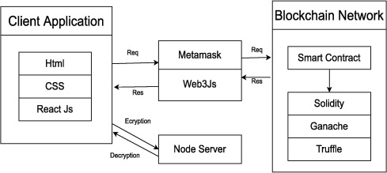
FLOW DIAGRAM

Slide 11
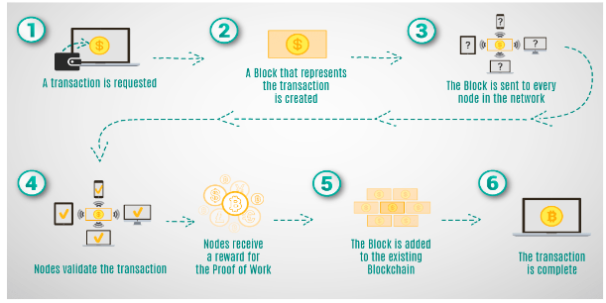
TECHNICAL ARCHITECTURE

Slide 12
CONCLUSION
A well-maintained and efficiently funded public infrastructure system is crucial for the prosperity and development of any region or country.
A fair and well-designed toll payment system can be an essential component of this, providing a sustainable source of revenue for infrastructure projects while ensuring that the burden is distributed equitably among users.
Ultimately, a well-implemented public infrastructure and toll payment system can enhance connectivity, safety, and economic growth while promoting a better quality of life for all.

Slide 13
FUTURE SCOPE
The project's future scope Ultimately, a well-implemented public infrastructure and toll payment system can enhance connectivity, safety, and economic growth while promoting a better quality of life for all.
Additionally, ongoing research and development in blockchain and toll payment system may lead to enhanced security, scalability, and usability, further strengthening the foundation for future electoral systems.

Slide 14
SOFTWARE REQUIREMENTS
Metamask
Node.js
Visual studio code
Remix IDE
Blockchain technology

Slide 15
SOURCE CODE
// SPDX-License-Identifier: MIT
pragma solidity ^0.8.0;
contract toll Collection{
struct TollData {
uint timestamp;
address collectedBy;
uint amount;
}
mapping(address => mapping(uint => TollData)) public tolls;
function payTollAmount(uint highwayId, uint _amount) public {
// TollData memory newToll = TollData(block.timestamp, msg.sender, amount);
tolls[msg.sender][highwayId].timestamp = block.timestamp ;
tolls[msg.sender][highwayId].collectedBy = msg.sender;
tolls[msg.sender][highwayId].amount += _amount;
}
function getToll(uint highwayId) public view returns (TollData memory) {
return tolls[msg.sender][highwayId];
}
// function updateToll(uint highwayId, uint amount) public {
// require(
// tolls[msg.sender][highwayId].timestamp > 0,
// "Toll data not found."
// );
// tolls[msg.sender][highwayId].amount = amount;
// }
}

Slide 16
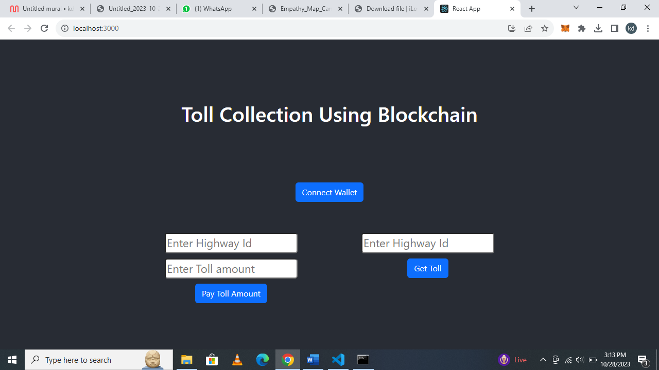
OUTPUT

Slide 17
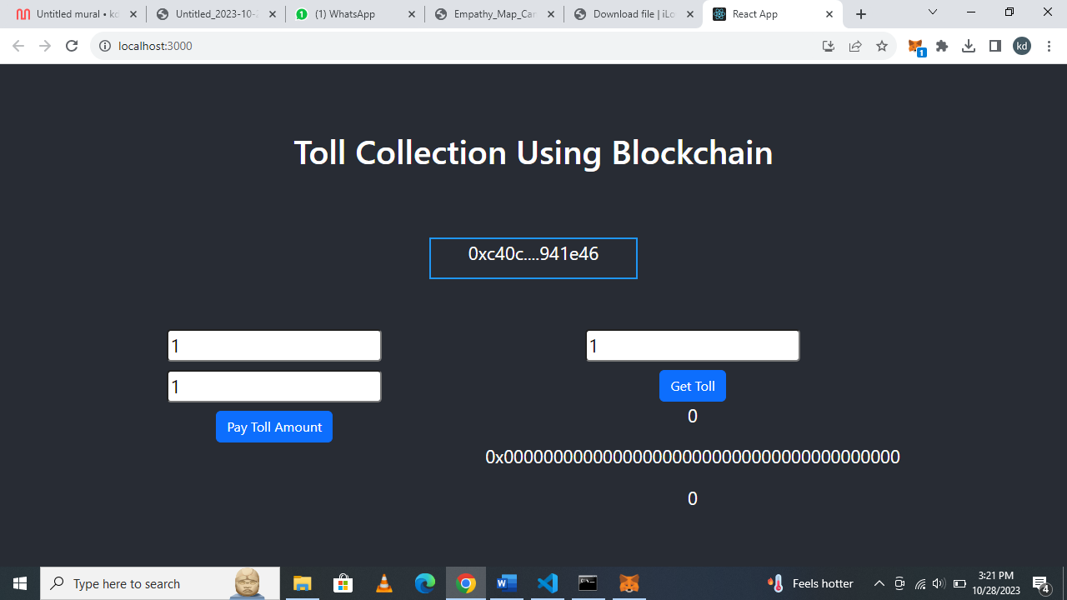

Slide 18
THANK YOU

